Slide 1

qmail
A simulative quantum channel
For simulative quantum computers

Slide 2
Who we are
Philippe Suchsland
Luca Dolfi
Marc Wyss
Keren Avnery
Cica Gustiani

Slide 3
Classical OSI model
Application
Transport
Network
Data Link
Physical
email
TCP / UDP
IP
MAC
Optical Fiber

Slide 4
Quantum OSI model
Application
Transport
Network
Data Link
Physical
qmail
Multi-party computation
Future Research & Develop

Slide 5


Current solution
QOTP

Slide 6
OUR solution
TCP
QOTP

Slide 7
DEMO
QMAIL implementation using QOTP

Slide 8


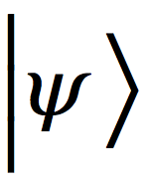
Teleportation
QUANTUM CHANNEL

Slide 9

QMAIL
CODE
ENCRYPTED QUANTUM CHANNEL
DECODE

Slide 10
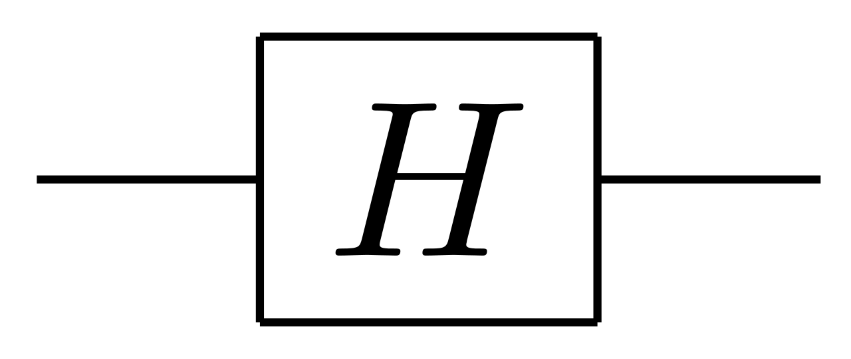
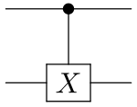
Multiparty Quantum Computation
U
Implemented Grover’s Algorithm
Private Oracle
…

Slide 11
Implementation
Close Channel
Send Qubits
Receive Qubits
Peer 2 Peer
Send statevector
Send circuit

Slide 12
Future Develop
Quantum Noise on the Channel
Send Access to Qubits
Receive Access to Qubits
Server & clients
Restrict access to Qubits
Send instructions,

